Slide 1
PSCS235-A One Stop Solution focusing on Tourism
PIP2001 Capstone Project
Review-1
Batch Number: G45
Under the Supervision of,
Ms. Sreelatha P.K
Associate Professor
School of Computer Science and Engineering
Presidency University
Roll Number | Student Name
20211CSE0846 | VAISHNAVI C
20211CSE0298 | SHRUTHI V
20211CSE0308 | RUTHIKA S SHETTY
Name of the Program: CSE
Name of the HoD: Dr. Asif Mohammed H.B
Name of the Program Project Coordinator: Mr. Amarnath J.L & Dr. Jayanthi. K
Name of the School Project Coordinators: Dr. Abdul Khadar A

Slide 2
Introduction
This project aims to create an innovative data mining solution capable of accurately forecasting tourists' travel preferences, specifically optimizing domestic tour packages' scheduling.
The project has three main objectives:
To build a clustering model that efficiently groups the collected data into distinct clusters for classification purposes.
To develop data mining models using predictive techniques to forecast tourist travel clusters, enabling more effective planning of domestic tour packages.
To provide well-founded and actionable recommendations to the appropriate authorities.

Slide 3
Literature Review
Tourist Movement Analysis Using Social Media Data (Andry Alamsyah, I Putu Willy Ditya, Tri Widarmanti)
The Impact of Artificial Intelligence on Tourism Sustainability: A Systematic Mapping Review (Fisnik Dalipi, Zenun Kastrati, Timmy Öberg)
Tourist Behaviour Analysis Based on Digital Pattern of Life (Sergei Mikhailov, Alexey Kashevnik, Alexander Smirnov)
A Personalized Hybrid Tourism Recommender System (Mohamed Elyes Ben Haj Kbaier, Hela Masri, Saoussen Krichen)
Prediction of Tourist Behaviour: Tourist Visiting Places by Adapting Convolutional Long Short-Term Deep Learning (Jaruwan Kanjanasupawan, Yi-Cheng Chen, Tipajin Thaipisutikul, Timothy K. Shih, Anongnart Srivihok)
Research on Smart Tourism System Based on Artificial Intelligence (Mengdan Xu)
Tourism Recommendation System Based on Knowledge Graph Feature Learning (Fengsheng Zeng, Yan’e Zheng)

Slide 4
Literature Review
Smart Tourism Route Planning System Based on Machine Learning Algorithm (Zhenzhen Yu; Shan Wang)
A Study on Sustainable Tourism and Application of Sentiment Analysis in the Tourism Industry (Chandra Prakash Gupta; V. V. Ravi Kumar)
Sentiment Analysis on Tourism Place using Naive Bayes (Aldy Rialdy Atmadja; Aprilia Rahmawati; Cecep Nurul Alam; Popon Dauni; Yogi Saputra)

Slide 5
Existing method Drawback
Tourist Movement Analysis Using Social Media Data
Some tourist destinations or countries may have limited social media activity, especially in rural or less digitally connected areas.
2. The Impact of Artificial Intelligence on Tourism Sustainability: A Systematic Mapping Review
Only published or readily available studies might have been included in the review, leading to potential bias.
3. Tourist Behavior Analysis Based on Digital Pattern of Life
Analyzing digital patterns of life often involves tracking personal data, including location, preferences, and behaviors. There are inherent privacy concerns.
4. A Personalized Hybrid Tourism Recommender System
Although hybrid systems aim to overcome the limitations of individual recommendation methods (content-based and collaborative filtering), they still often face issues with new users or tourists who haven't generated enough data.

Slide 6
Existing method Drawback
4. Predicting Tourist Behavior Using Deep Learning and Social Media Data:
Reliance on social media data can introduce biases, as not all demographics are represented equally.
5. A Hybrid Recommender System for Personalized Tourism Recommendations
The recommender system may struggle to provide accurate recommendations for new users or items with limited data.
6. Customer Behavior Analysis in the Tourism Industry Using Data Mining Techniques
The accuracy of data mining results depends on the quality of the data used. Inaccurate or incomplete data can lead to misleading insights.
7. A Deep Learning Approach for Tourist Attraction Recommendation Based on User Preferences
Deep learning models can be prone to overfitting, especially with limited data, which can lead to poor generalization performance.

Slide 7
Existing method Drawback
8. Smart Tourism Route Planning System Based on Machine Learning Algorithm:
Relies heavily on large datasets and poses privacy concerns, complicating implementation.
9. A Study on Sustainable Tourism and Application of Sentiment Analysis in the Tourism Industry :
Subjective sentiment analysis may yield inaccuracies and may not represent all tourists due to reliance on online reviews.
10. Sentiment Analysis on Tourism Place using Naive Bayes:
Oversimplifies data relationships and assumes feature independence, potentially compromising sentiment classification accuracy.

Slide 8
Proposed Method
Clustering Tourist Data:
Implement clustering algorithms such as K-means, DBSCAN, and hierarchical clustering.
Segment data based on demographics, preferences, and behaviors to identify patterns in tourist groups.
Predictive Modeling for Tourist Clusters:
Build time series, regression, and classification models to forecast tourist travel trends.
Predict future changes in cluster composition and behavior.
Result Analysis:
Analyze clusters and predictions to identify trends and tourist preferences.
Focus on key characteristics within each group for targeted insights.
Recommendations for Tourism Authorities:
Provide data-driven suggestions to optimize resource allocation, marketing, and services.
Propose strategic actions for enhancing tourism offerings based on cluster analysis.
Visualization of Clustering and Predictions:
Present the clustering results and predictions in an easily understandable and insightful manner.
Enhance the clarity of results, making the insights more accessible to stakeholders.

Slide 9
Objectives
Objective 1: Develop a robust clustering algorithm for tourist data segmentation
Explore and implement various clustering algorithms (e.g., K-means, hierarchical clustering, DBSCAN) to effectively segment tourist data based on relevant attributes (e.g., demographics, preferences, behaviors).
Objective 2: Construct predictive models for forecasting tourist travel clusters
Develop and evaluate predictive models (e.g., time series analysis, regression models, classification models) to forecast the evolution of tourist clusters over time.
Objective 3: Analyze and interpret the results of clustering and predictive models
Conduct an in-depth analysis of the clusters identified and the predictions generated by the models, identifying key characteristics and trends.
Objective 4: Develop actionable recommendations for tourism authorities
Based on the clustering and predictive results, provide specific and actionable recommendations to tourism authorities, such as optimizing resource allocation, developing targeted marketing campaigns, and improving service offerings.

Slide 10
Methodology/Modules
Methodology:
Data Collection: Gather data from social media, travel platforms, and user interactions.
Data Pre-processing: Clean, normalize, and extract relevant features.
NLP: Analyse text for sentiment, topics, and entities.
Machine Learning: Build models for recommendation, prediction, and clustering.
Knowledge Graph: Construct a graph representation of the tourism domain.
Visualization: Create interactive dashboards for insights.

Slide 11
Methodology/Modules
Modules:
Python Libraries: pandas, NumPy, scikit-learn, TensorFlow, Keras, NLTK.
Social Media APIs: Twitter, Instagram, Facebook
NLP Tools: spaCy, NLTK
Knowledge Graph Frameworks: Neo4j

Slide 12
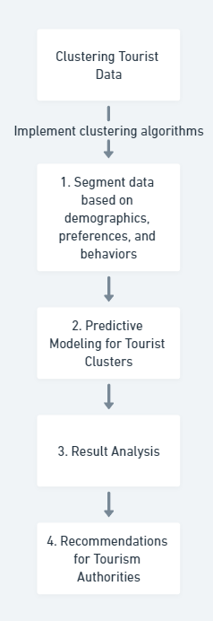
Architecture

Slide 13
Hardware/software components
Python 3. x
Jupyter Notebook / Google Colab
Pandas, NumPy (Data processing)
Matplotlib, Seaborn, Plotly (Visualization)
Scikit-learn, TensorFlow, PyTorch (Machine Learning)
BeautifulSoup / Scrapy (Web scraping)
APIs (Google Maps, OpenWeather, Instagram, etc.)

Slide 14
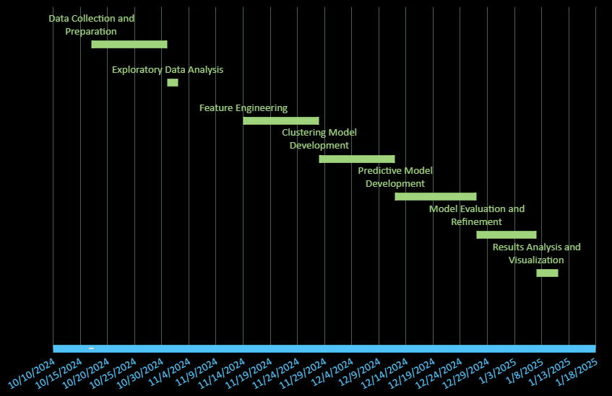
Timeline of Project

Slide 15
Expected Outcomes
1. Accurate Tourist Segmentation:​
The clustering model is expected to effectively segment tourists based on demographics, preferences, and behaviors. This will allow tourism authorities and companies to understand different tourist groups better and cater to their needs.​
2. Improved Forecasting of Tourist Travel Patterns:​
Predictive models developed will help forecast future tourist behaviors and travel preferences, enabling tourism operators to plan more efficiently and anticipate the needs of tourists in real-time.​
3. Optimized Tour Package Scheduling:​
By forecasting tourist travel clusters, the project aims to optimize the scheduling and customization of domestic tour packages, increasing efficiency in resource allocation and improving tourist satisfaction.​
4. Actionable Insights for Tourism Authorities:​
The analysis of the clusters and predictions will provide tourism authorities with actionable insights, such as how to allocate resources, design targeted marketing campaigns, and improve service offerings.​
5. Contribution to Sustainable Tourism:​
The project will contribute to sustainable tourism practices by optimizing travel routes and packages, reducing unnecessary travel, and promoting eco-friendly options aligned with sustainability goals.​

Slide 16
Conclusion
This AIML project aims to enhance the tourism industry through advanced data analysis techniques. By building an efficient clustering model, we can categorize tourist data into distinct segments, improving our understanding of traveler demographics and preferences.
Our predictive models will also forecast travel patterns, enabling better planning of domestic tour packages tailored to specific tourist needs. The actionable recommendations derived from our analyses will empower tourism authorities to make informed decisions, optimize resource allocation, and promote sustainable practices.
Ultimately, this project seeks to create a more efficient and responsive tourism ecosystem, fostering growth and sustainability in the industry.

Slide 17
GitHub Link
The Github link provided should have public access permission.
https://github.com/vaishnavi-c-2025/A-One-Stop-Solution-focusing-on-Tourism

Slide 18
References
https://ieeexplore.ieee.org/document/9701947
https://ieeexplore.ieee.org/document/10131818
https://ieeexplore.ieee.org/document/9263945
https://ieeexplore.ieee.org/document/8308293
https://ieeexplore.ieee.org/document/8823542
https://ieeexplore.ieee.org/document/10165293
https://ieeexplore.ieee.org/document/9076546
https://ieeexplore.ieee.org/document/9695769
https://ieeexplore.ieee.org/document/10072232
https://ieeexplore.ieee.org/document/10704180
https://ieeexplore.ieee.org/document/10366891
https://www.data.gov.in/

Slide 19
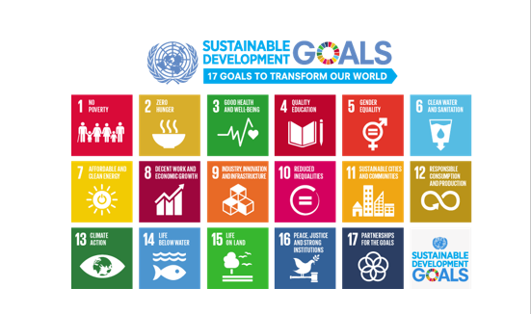
Project work mapping with SDG
SDG 11: Sustainable Cities and Communities: Our project focuses on improving the sustainability of tourism, which can contribute to sustainable urban development and better quality of life for residents.
SDG 9: Industry, Innovation, and Infrastructure: Our project leverages AI and machine learning technologies, which are considered key drivers of innovation and technological progress.

Slide 20
Thank You

